Slide 1

“Microsoft Studios”:
Should Microsoft Enter the Movie Business?
G. Haws & K. Hayes

Slide 2
In order to maximize its investment, what scale of films should Microsoft produce?
What types of studios, producers, and directors should Microsoft seek out?
Sources:
TheMovieDB.org
Box Office Mojo
IMBD

Slide 3
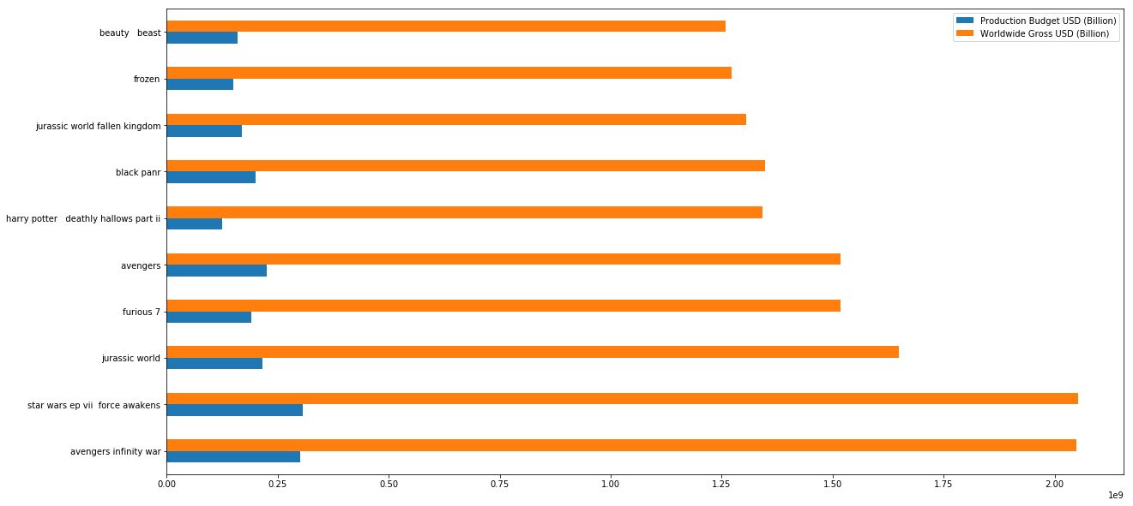
Top grossing movies (2010-Present)

Slide 4
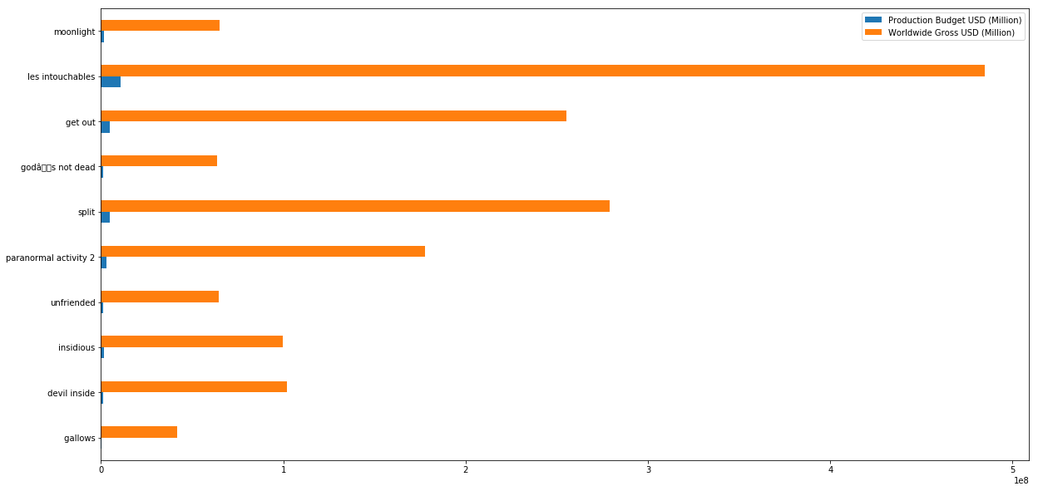
Top ROI movies (2010-Present)

Slide 5
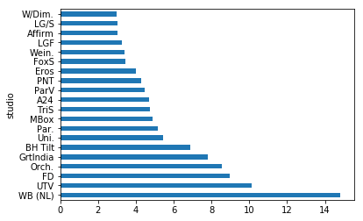
Top ROI Studios (2010-Present)

Slide 6
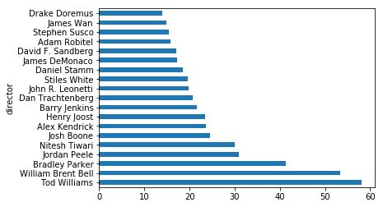
Top ROI Studios (2010-Present)
Outlier: Travis Cluff : 415.56

Slide 7
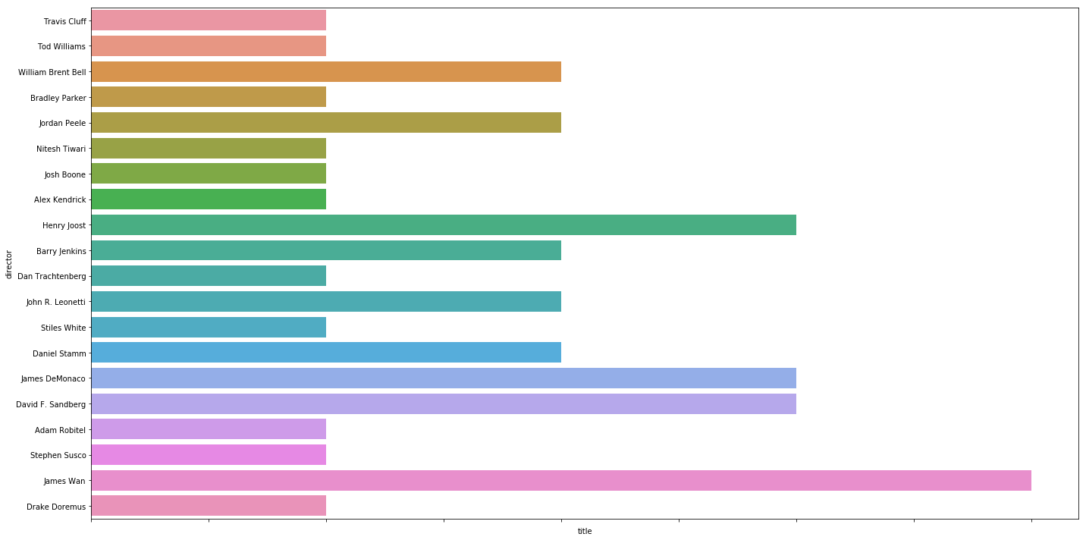
Size of ROI director filmography

Slide 8
Recommendations
Instead of focusing on overall returns, focus on ROI.
Model operations on studios capable of producing films that maximize ROI.
Hire directors that can creating engaging films, despite heavy budgetary constraints.
Hire new directors.

